Slide 1

Introduction to Deep Learning Applications and Theory
Week 8
Lecture 23
ECE 596 / AMATH 563

Slide 2
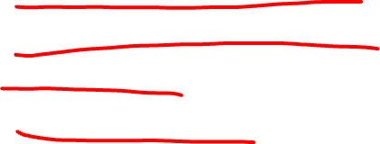
Previous Lecture:
Generative Models and Adversaries
Generative Models Definition
Generative Models Taxonomy
Fully Visible BN
Variational Approach

Slide 3
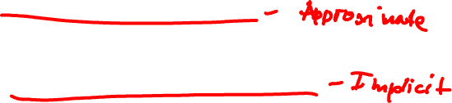
This Lecture:
Generative Models and Adversaries
Variational AutoEncoder
Generative Adversarial Models
Generator
Discriminator

Slide 4
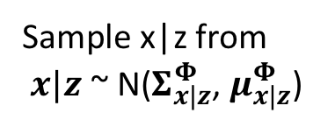
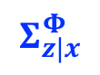
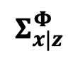
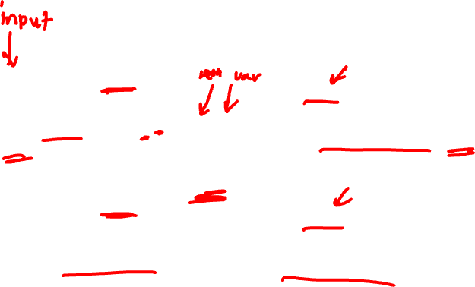
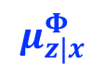
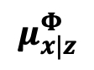
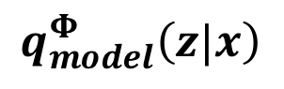
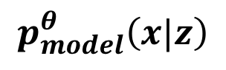
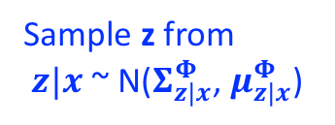
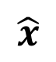
Variational Autoencoder Putting it All Together
x
$$Σ_{z|x}^{Φ}$$
$$Σ_{x|z}^{Φ}$$
Sample z from
$z|x$ ~ N($Σ_{z|x}^{Φ}$, $μ_{z|x}^{Φ}$)
Encoder
Sample x|z from
$x|z$ ~ N($Σ_{x|z}^{Φ}$, $μ_{x|z}^{Φ}$)
$$\hat{x}$$
z
$$μ_{z|x}^{Φ}$$
$$μ_{x|z}^{Φ}$$
$$q_{model}^{Φ}\left(z|x\right)$$
$$p_{model}^{θ}\left(x|z\right)$$

Slide 5
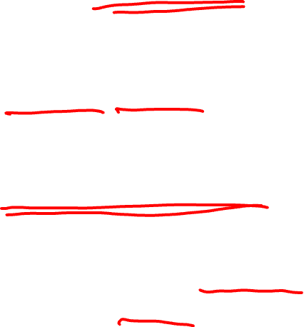
Unsupervised Learning
Data:
{x} x: inputs NO labels
Neural Network Goal:
Learn a structure of the data
Examples: Feature learning, clustering, dimension reduction, synthesizing (density estimation), prediction

Slide 6
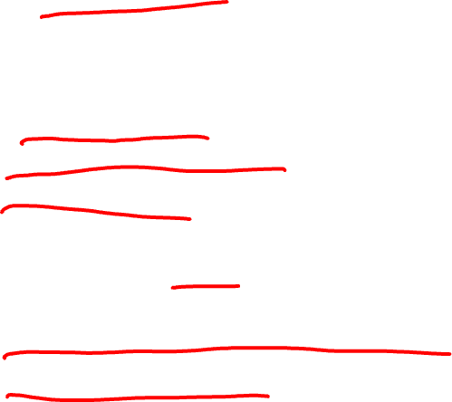
Unsupervised Learning with NN
Data:
{x} x: inputs NO labels
+ Can have much more data
- Challenge: Cost?
Neural Network Goal:
Learn a structure of the data
+ Has the potential to learn the real world
- Challenge: Optimization?

Slide 7
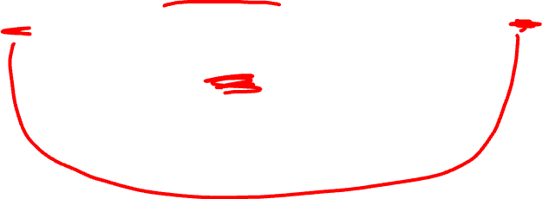
Variational Autoencoder Putting it All Together
x
$$Σ_{z|x}^{Φ}$$
$$Σ_{x|z}^{Φ}$$
Sample z from
$z|x$ ~ N($Σ_{z|x}^{Φ}$, $μ_{z|x}^{Φ}$)
Encoder
Sample x|z from
$x|z$ ~ N($Σ_{x|z}^{Φ}$, $μ_{x|z}^{Φ}$)
$$\hat{x}$$
z
$$μ_{z|x}^{Φ}$$
$$μ_{x|z}^{Φ}$$
$$q_{model}^{Φ}\left(z|x\right)$$
$$p_{model}^{θ}\left(x|z\right)$$

Slide 8
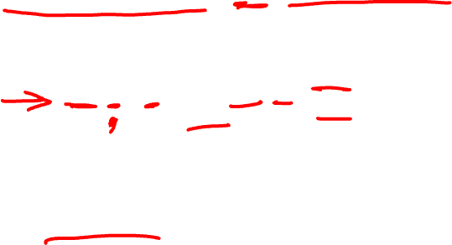
Kullback-Leibler (KL) Divergence

Slide 9

Variational Autoencoder Putting it All Together
x
$$Σ_{z|x}^{Φ}$$
$$Σ_{x|z}^{Φ}$$
Sample z from
$z|x$ ~ N($Σ_{z|x}^{Φ}$, $μ_{z|x}^{Φ}$)
Encoder
Sample x|z from
$x|z$ ~ N($Σ_{x|z}^{Φ}$, $μ_{x|z}^{Φ}$)
$$\hat{x}$$
z
$$μ_{z|x}^{Φ}$$
$$μ_{x|z}^{Φ}$$
$$q_{model}^{Φ}\left(z|x\right)$$
$$p_{model}^{θ}\left(x|z\right)$$
2
1

Slide 10
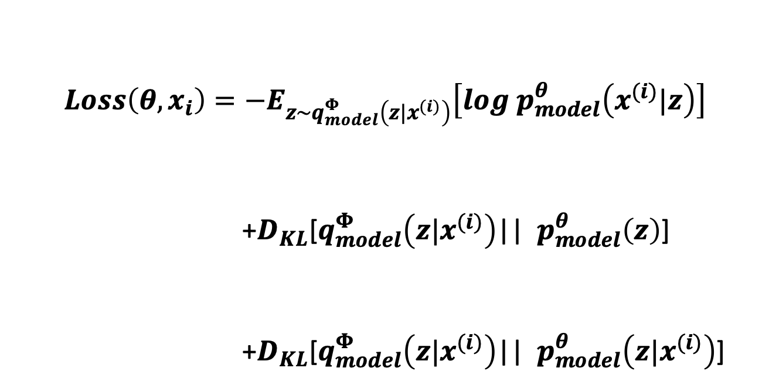

Log Likelihood Expression
$$Loss\left({θ,x}_{i}\right)=−E_{z\sim q_{model}^{Φ}\left(z|x^{(i)}\right)}\left[log{ p}_{model}^{θ}\left(x^{(i)}|z\right)\right]$$
+$D_{KL}$[$q_{model}^{Φ}\left(z|x^{(i)}\right)$|| ${ p}_{model}^{θ}\left(z\right)$]
+$D_{KL}$[$q_{model}^{Φ}\left(z|x^{(i)}\right)$|| ${ p}_{model}^{θ}\left(z|x^{(i)}\right)$]
1
decoder
Lower
Bound
= Loss
2
encoder
z prior
> =0
Kingma & Welling (ICLR 2014)

Slide 11
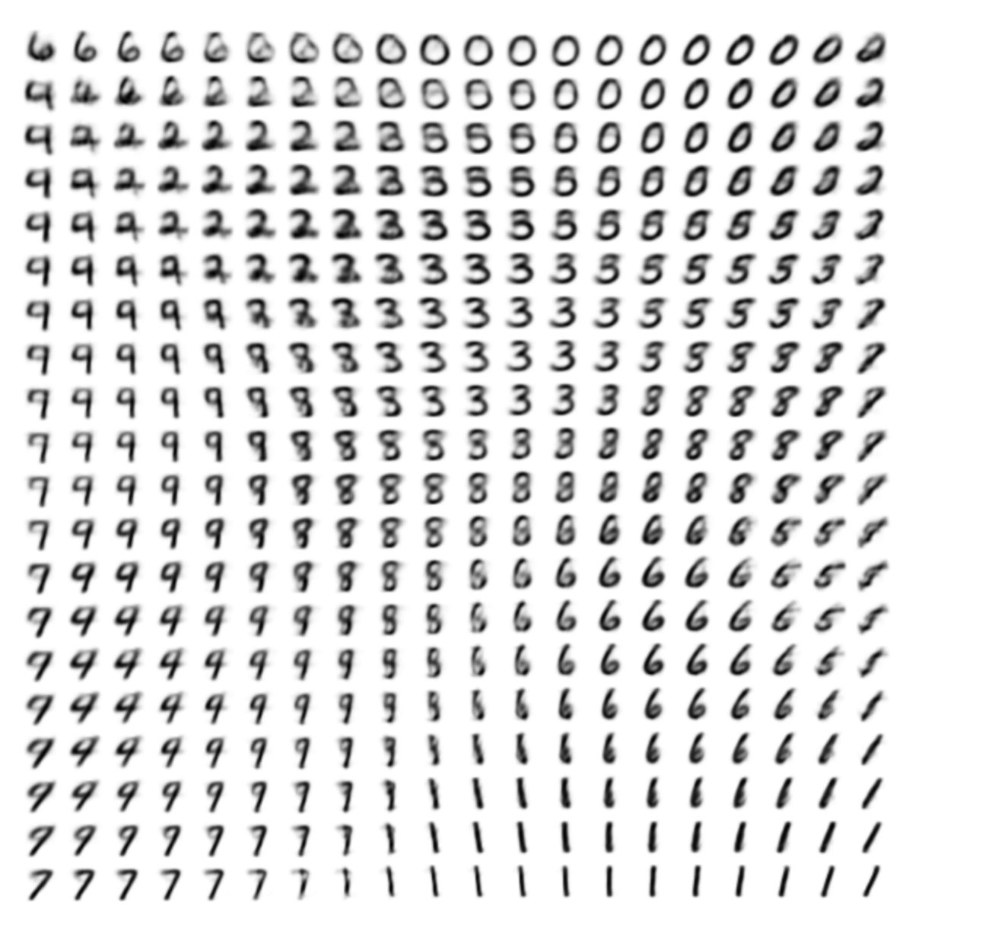

Generating Data
$$Σ_{z|x}^{Φ}$$
Sample x|z from
$x|z$ ~ N($Σ_{x|z}^{Φ}$, $μ_{x|z}^{Φ}$)
$$\hat{x}$$
z
Vary z2
$$μ_{z|x}^{Φ}$$
$$p_{model}^{θ}\left(x|z\right)$$
Vary z1
Kingma & Welling (ICLR 2014)

Slide 12
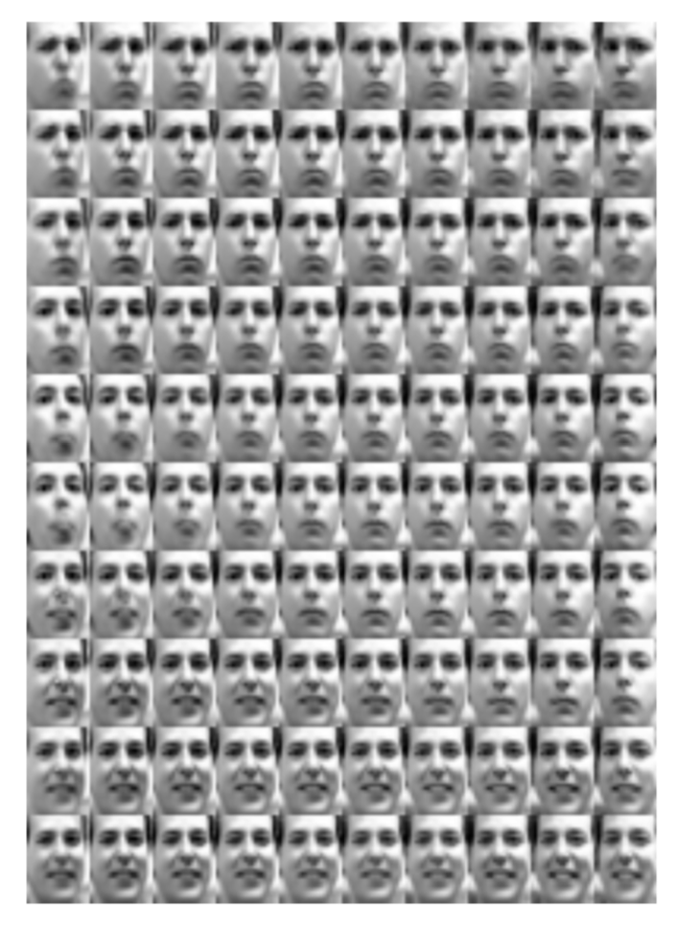
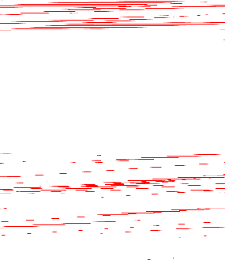
Generating Data
$$Σ_{z|x}^{Φ}$$
Sample x|z from
$x|z$ ~ N($Σ_{x|z}^{Φ}$, $μ_{x|z}^{Φ}$)
$$\hat{x}$$
z
Vary z2
$$μ_{z|x}^{Φ}$$
$$p_{model}^{θ}\left(x|z\right)$$
Vary z1
Kingma & Welling (ICLR 2014)

Slide 13

Variational Encoders
Probabilistic approach to autoencoders
+ Principled
+ Inferring features (z)
- Maximizes lower bound only

Slide 14
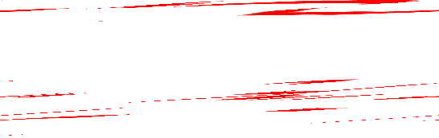
Generative Adversarial Networks
Density Estimation
Direct
GAN
Explicit Density
Implicit Density
Tractable Density
Approximate Density
Markov Chain
Fully Visible BN
Pixel RNN / CNN
Nonlinear ICA
Variational
Markov Chain
Variational Autoencoder

Slide 15
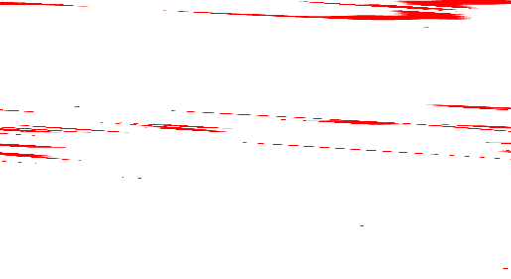
GANs
+ Use Latent Variables
+ Asymptotically Consistent (unlike VAG)
+ Potentially Can Reach Global Optimum
+ No Markov Chains Needed
Unprincipled
Could Take Long Time to Converge

Slide 16

GANs
Instead of sampling from high dimensional, complex and unknown distribution
Sample from simple distribution, e.g. normal distribution (random noise) and find transformation to the distribution we want to learn.
Learn the transformation using a NN

Slide 17
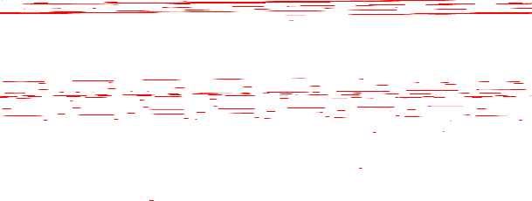
Two player game
Generator – try to generate samples and present them as real world and fool the discriminator
Discriminator – try to distinguish between real and generated (fake) images

Slide 18

Generator Network
Training data has distribution p_{data.}
Sample x ~ p_{data.}
Output sample x^{G}
Require: Output sample x^{G} is of similar dimensions as x and distribution p_{data.}
Neural Network
(G)
z

Slide 19
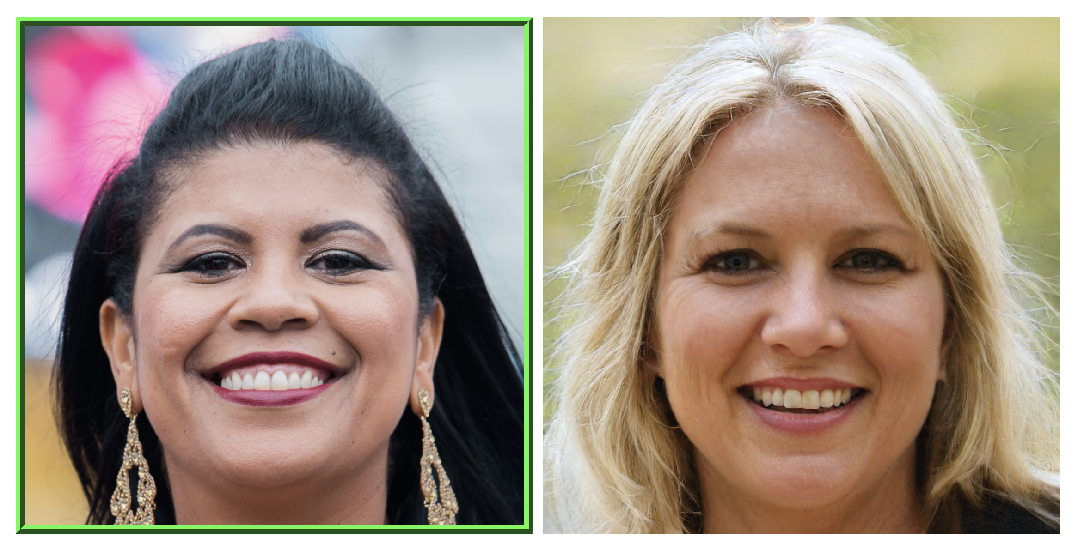
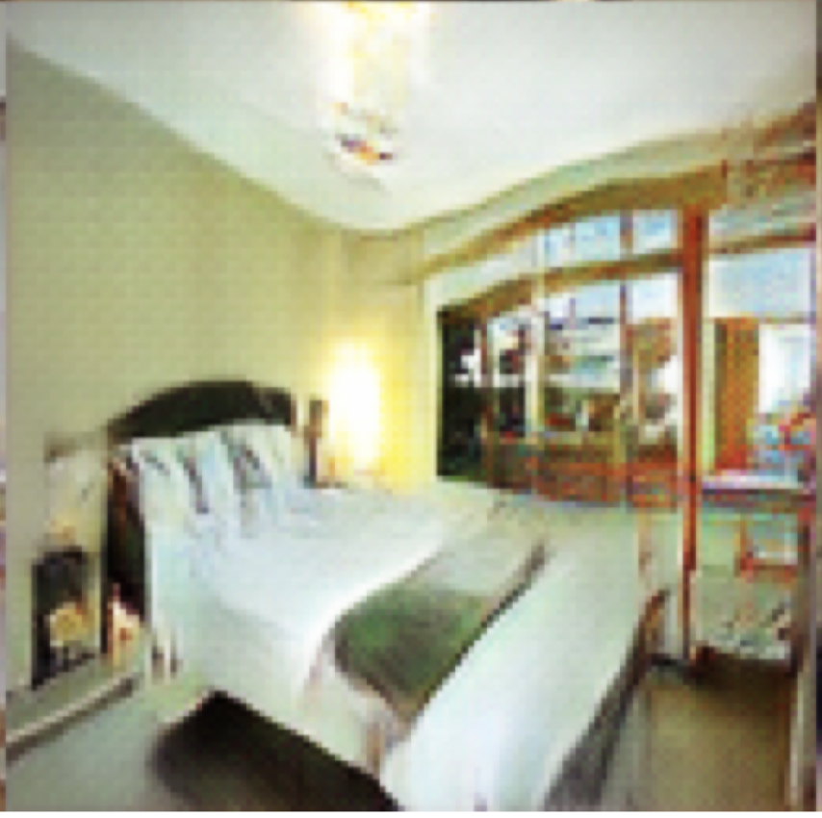
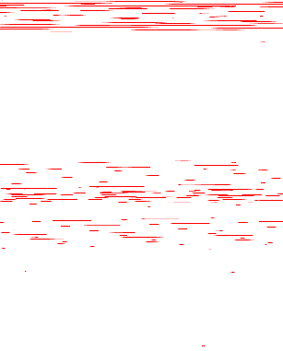
Examples
Face:
Tesla Car:
Bedroom:

Slide 20

Discriminator
Receives input of same dimensions as p_{data.}
Input sample x
Determine: is sample from p_{data} (1) or not (0).
Neural Network
(D)
0/1

Slide 21

Examples
Discriminator
Face:
0
Tesla Car:
0
Bedroom:
0

Slide 22
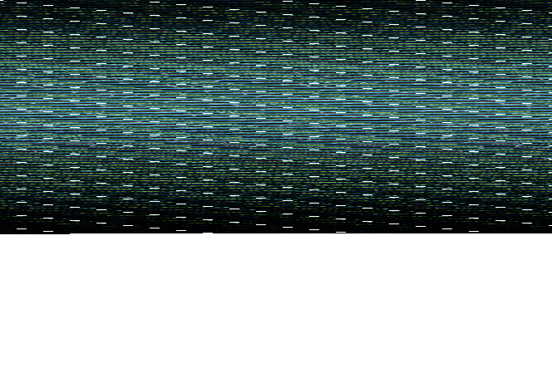
Combine Into a Game
x^{G}
x
Output samples x^{G}
Input sample x
Neural Network
(G)
Neural Network
(D)
z
0/1

Slide 23

GAN Intuition
D(G(z))
“Cost”: $\left\|D(G(z))\right\|$
Discriminator NN
(D)
x
Generator NN
(G)
“Cost”: $\left\|D\left(G\left(z\right)\right)−1\right\|$
z

Slide 24

Questions
How would you formulate training of such a network as an optimization problem.
What’s the cost?
How would you optimize it?
What is the desired solution?

Slide 25
Competing Cost Functions
$J^{(D)}=−\frac{1}{2}𝔼_{x\sim p_{data}}\log{D_{θ_{d}}\left(x\right)}−\frac{1}{2}𝔼_{z\sim p_{model}}\log\left(1−{D_{θ_{d}}(G}_{θ_{g}}\left(z\right))\right)$
$J^{(G)}=−J^{(D)}$
$J^{(D)}=−\frac{1}{2}\int{p_{data}\left(x\right)\log{D\left(x\right)dx}}−\frac{1}{2}\int{p_{model}\left(x\right)}\log\left(1−D\left(x\right)\right)dx$

Slide 26
Question 2
Instead of $θ_{d}$ assume that we optimize $D(x)$ for every value of $x$. What would be the optimal strategy for $D(x)$ ?
What assumptions are needed?
$J^{(D)}=−\frac{1}{2}\int{p_{data}\left(x\right)\log{D\left(x\right)dx}}−\frac{1}{2}\int{p_{model}\left(x\right)}\log\left(1−D\left(x\right)\right)dx$

Slide 27
Solution
Optimal $D(x)$ is
$$D(x)=\frac{p_{data}}{p_{model}+p_{data}}$$
Assumption: $p_{model}, p_{data}$ are nonzero everywhere
Equilibrium: $p_{model}=p_{data}$ then $D(x)=\frac{1}{2}$

Slide 29
Unsupervised -> Supervised
Data
Discriminator
Model
In GANs, the fact that the discriminator learns an approximation of the
ratio p_{data}(x)/p_{model}(x) is the key insight that allows it to work and makes
it distinctly different from other generative models that learn p_{model} (x) directly
(or indirectly via latent variable models).

Slide 30
Minimax Game Optimization
$$\min_{θ_{g}}{\max_{θ_{d}}\left[𝔼_{x\sim p_{data}}\log{D_{θ_{d}}(x)}+𝔼_{z\sim p_{model}}\log{(1−{D_{θ_{d}}(G}_{θ_{g}}\left(z\right)))}\right]}$$
Discriminator output
for real data
Discriminator output
for generated data
Solution:
Saddle point in the parameter space (Nash Equillibrium)
Similar to solution of Jensen-Shannon Divergence

Slide 31
Question 3
How would a pseudo code for GAN training look like?
Can you think of some variations?

